Slide 1
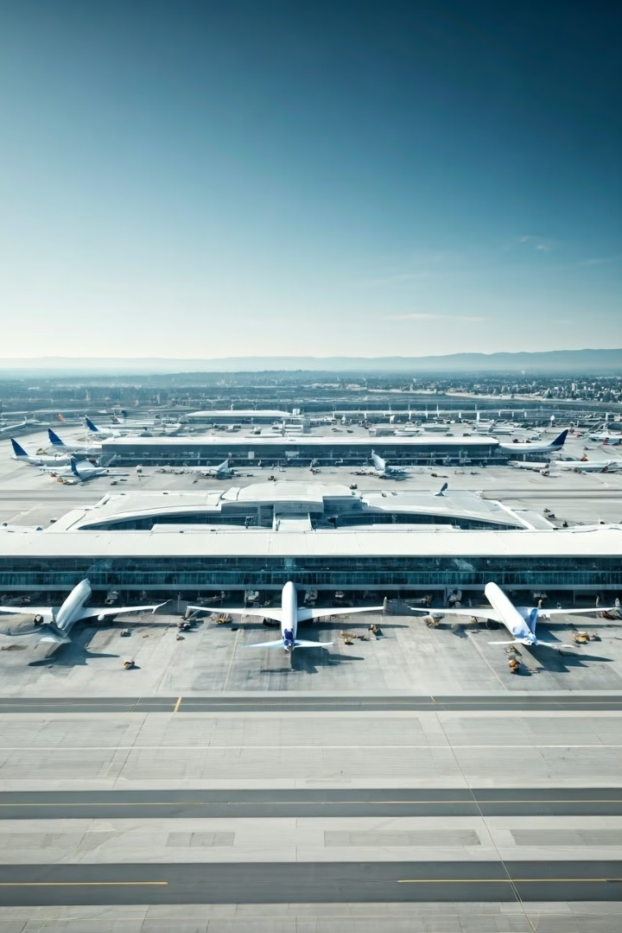
Optimizing United Airlines' Call Center Operations
Objectives
Decrease Average Handle Time (AHT) and Average Speed to Answer (AST).
This presentation will explore strategies to enhance customer satisfaction, reduce escalations, and improve overall operational efficiency in the call center.
Team Name: Ninja
Leader: Nakul Garg
Member: Disha Aggarwal
Notes:
1

Slide 2
Current State of Call Center Metrics
Average Handle Time (AHT)
The average time agents spend on a call, from answering to disconnecting.
Current AHT: 18.90 minutes.
This impacts agent availability and the overall customer experience.
Average Speed to Answer (AST)
The average time customers wait before their call is answered by an agent.
Current AST: 7.28 minutes.
Long AST contributes to higher customer dissatisfaction and abandoned calls.
Notes:
2

Slide 3
Factors Contributing to Extended
Average Handle Time (AHT)
Call Types
Calls Longer Than 10 Minutes: 10,579 (15.87% of total calls)
Top Reasons for Long Calls:
IRROPS: 2,454 calls
Booking: 1,606 calls
Communications: 1,077 calls
Upgrade: 931 calls
Products and Services: 902 calls
Sentiment
The correlation between Average Sentiment and Handling Time is -0.07.
This indicates a weak negative relationship, meaning that as sentiment becomes slightly more negative, the handling time increases slightly.
Notes:
4

Slide 4
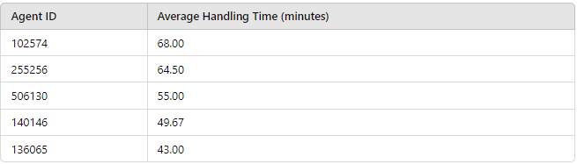
Agent Performance
Top 5 Agents with Longest Average Handling Time

Slide 5
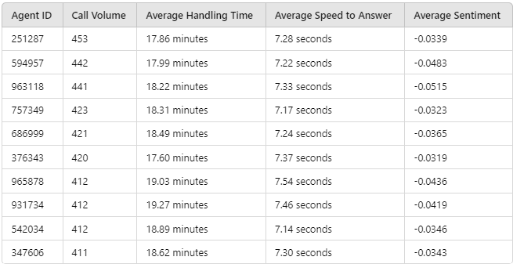
Key Drivers of Long AHT and AST
Agent Performance
Top 10 Agents by Call Volume
Notes:
2

Slide 6
Call Types
Top 3 Primary Reasons for longer AHT
Check out
ETC
Post Flight
Top 3 Primary Reasons for longer AST
Checkout
Traveler Updates
Unaccompanied Minor
Percentage difference between AHT for the most frequent and least frequent call reasons:
Most Frequent Reason: IRROPS - AHT: 19.086 minutes
Least Frequent Reason: Unaccompanied Minor - AHT: 20.125 minutes
Average AHT Percentage Difference: -5.16%

Slide 7
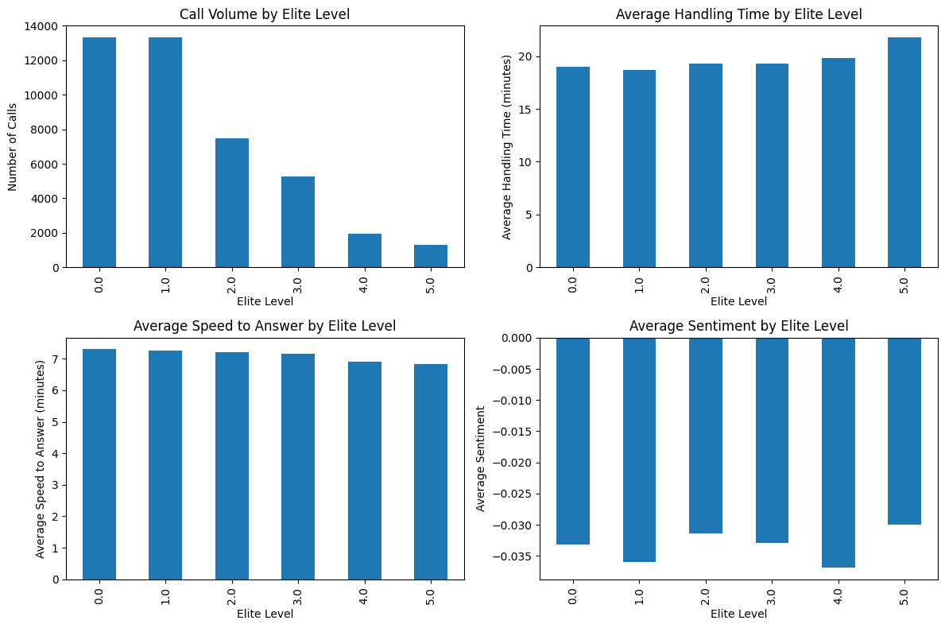
Elite Level

Slide 8
Problems solved using IVR
Switching to IVR for Short Calls
Total Short Calls per Day: 1,511
Total Agent Time Saved:
By Switching to IVR: 77,752 minutes
Equivalent to: 1,295.87 hours
Total Average Handle Time for Short Calls: 7.35 hours
Average Time Saved per Day per Agent: 29.00 minutes
Notes:
2

Slide 9
Proposed IVR Improvements
Enhanced Call Reason Identification
Use NLP to accurately categorize caller intent.
Comprehensive Self-Service Options
Expand functionalities for common inquiries (e.g., booking changes).
Dynamic FAQ Integration
Provide real-time, relevant information based on current data.
User-Friendly Menu Structure
Simplify menu options to reduce customer confusion.
Proactive Call Back Options
Allow customers to request a callback instead of waiting on hold.
Post-Call Surveys
Gather feedback on IVR experience for continuous improvement.
Educational IVR Messages
Inform customers about self-service options during the call.

Slide 10
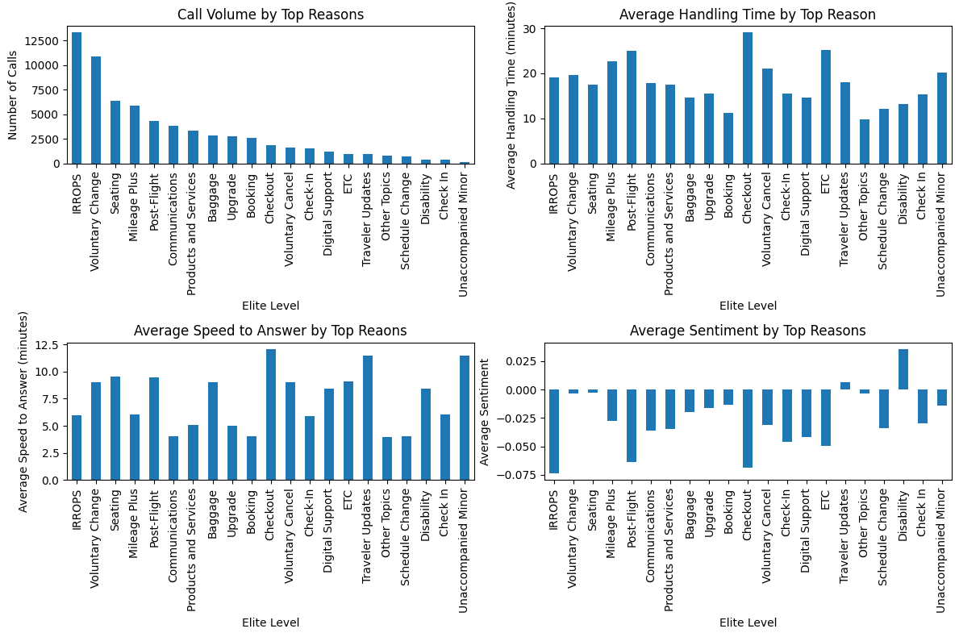
Categorizing Call Reasons to Optimize Customer Support

Slide 11


Recommendations for Optimization
1
Enhance IVR Capabilities
Implement self-service options for the top 5 call reasons.
Optimize IVR menu structure based on call frequency.
2
Agent Training and Tools
Develop a training program based on top-performing agents’ techniques.
Implement a knowledge management system for quick information access.
3
Workforce Management
Use hourly call volume data for optimized staffing during peak hours.
Introduce a call-back option during high-volume periods.
Notes:
5

Slide 12
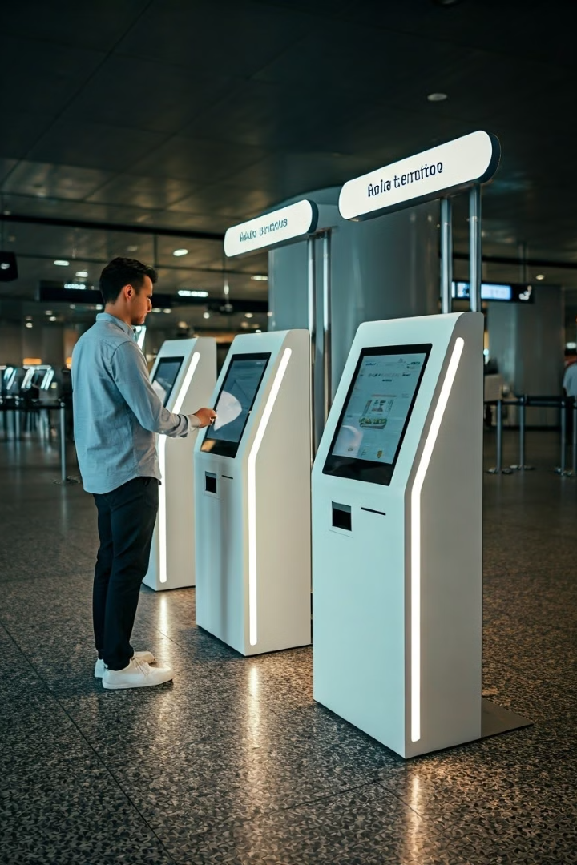
Expected Impact
Reduction in Average Handle Time (AHT):
Projected decrease of 20%, leading to more efficient call handling and improved agent productivity.
Reduction in Average Speed to Answer (AST):
Anticipated decrease of 30%, resulting in minimized customer wait times and enhanced customer experience.
Improved Customer Satisfaction Scores:
Higher customer satisfaction ratings due to reduced resolution times and better service quality.
Efficient Use of Call Center Resources:
More effective allocation of resources, leading to reduced operational costs and improved service levels.
Notes:
6

Slide 13
Thank You!!

